Slide 1
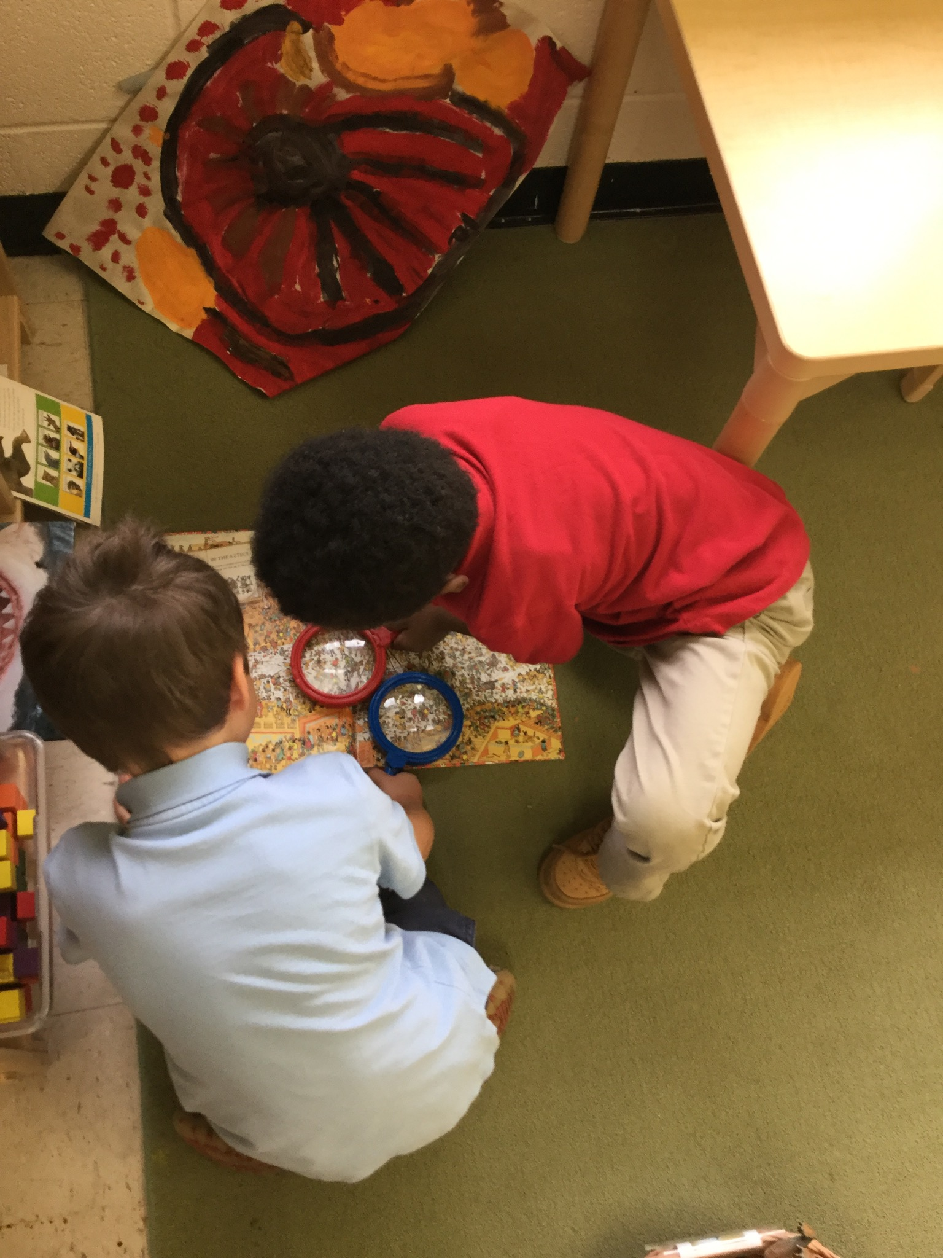
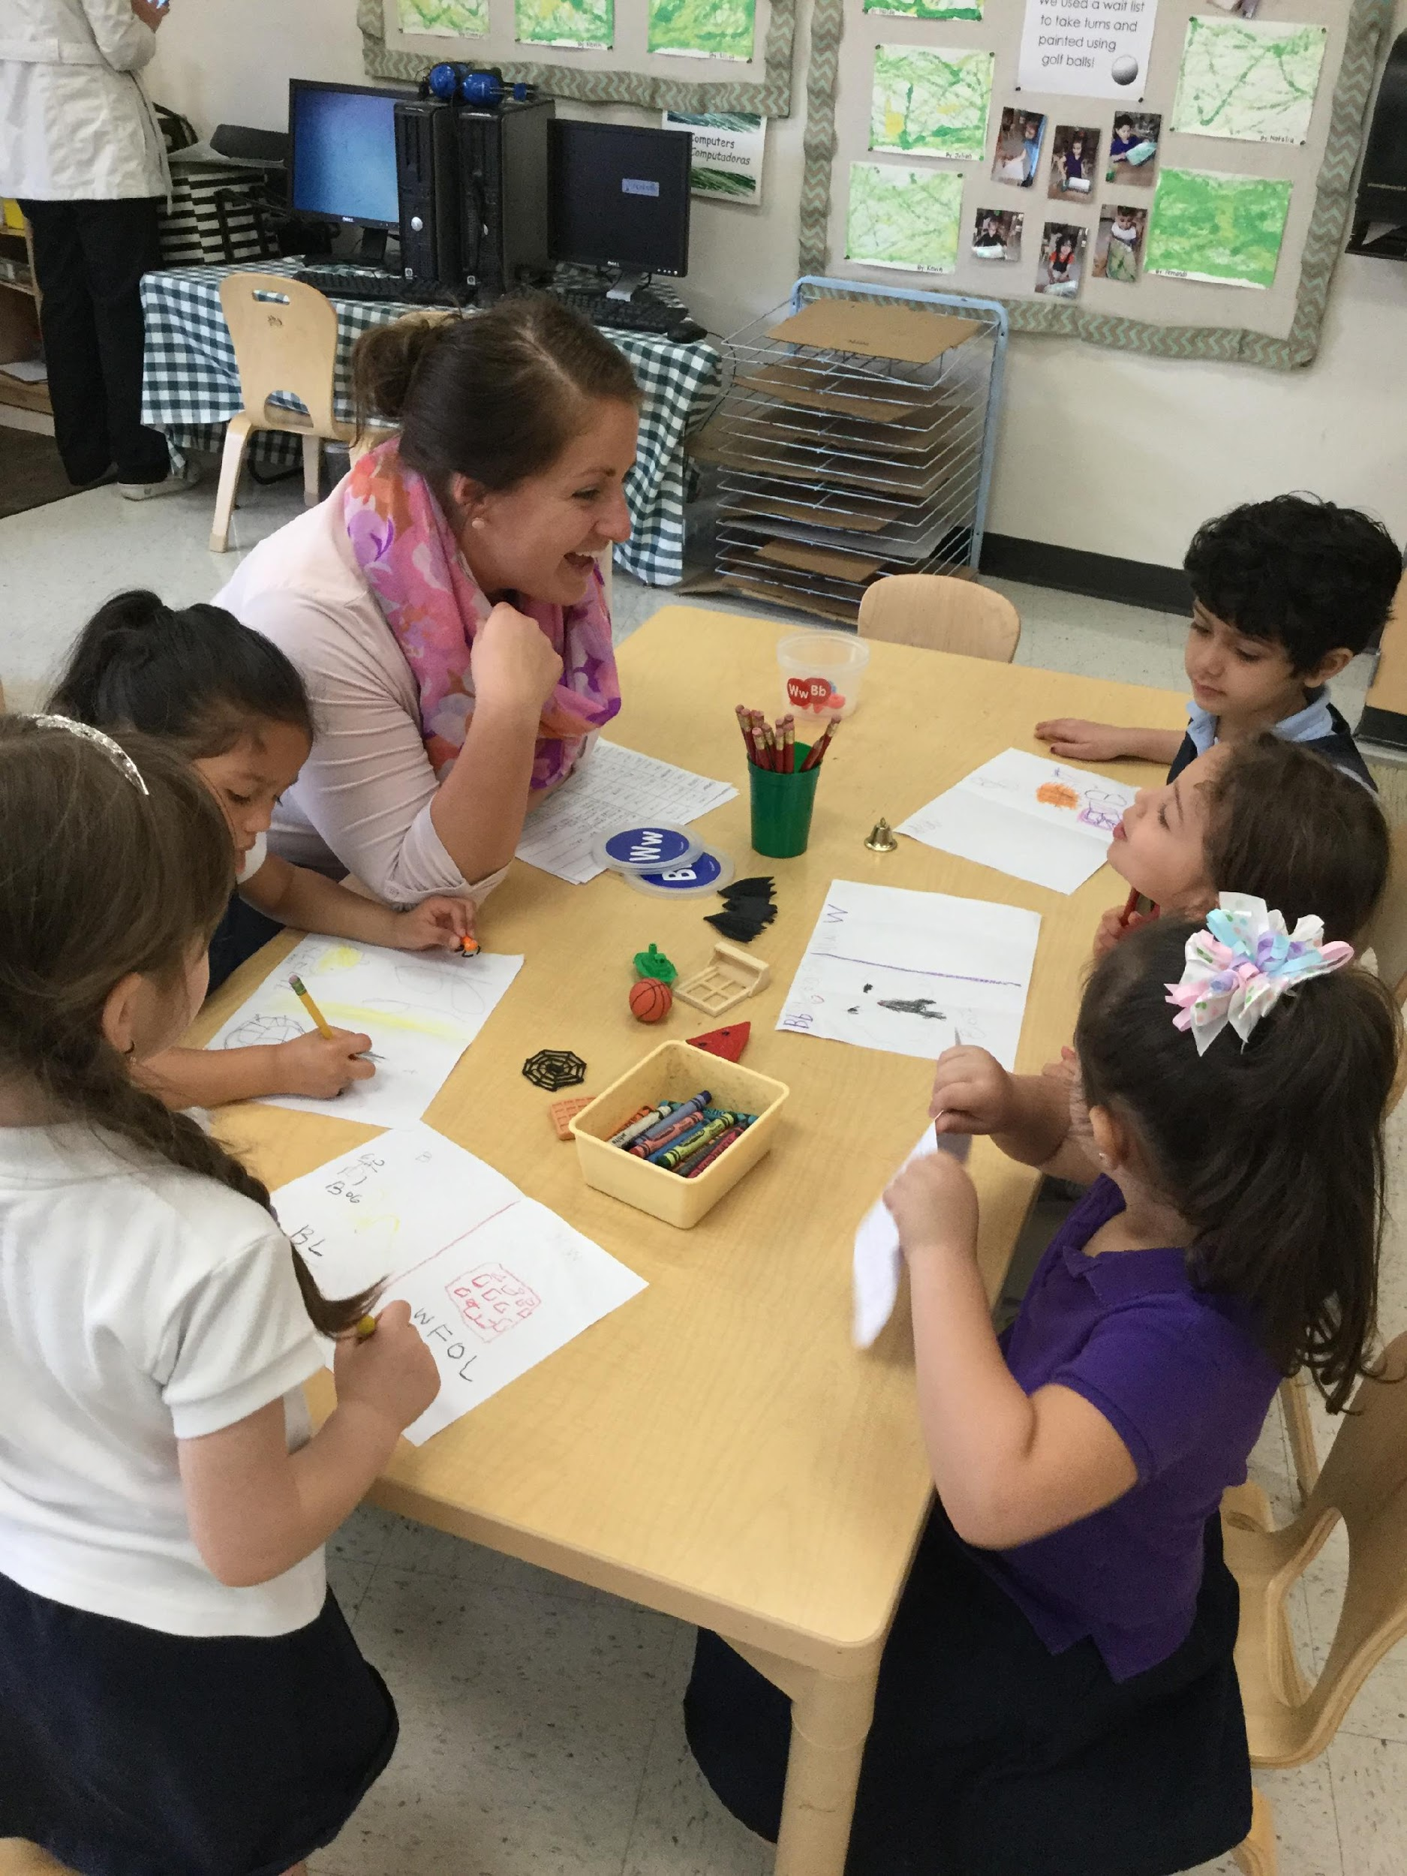
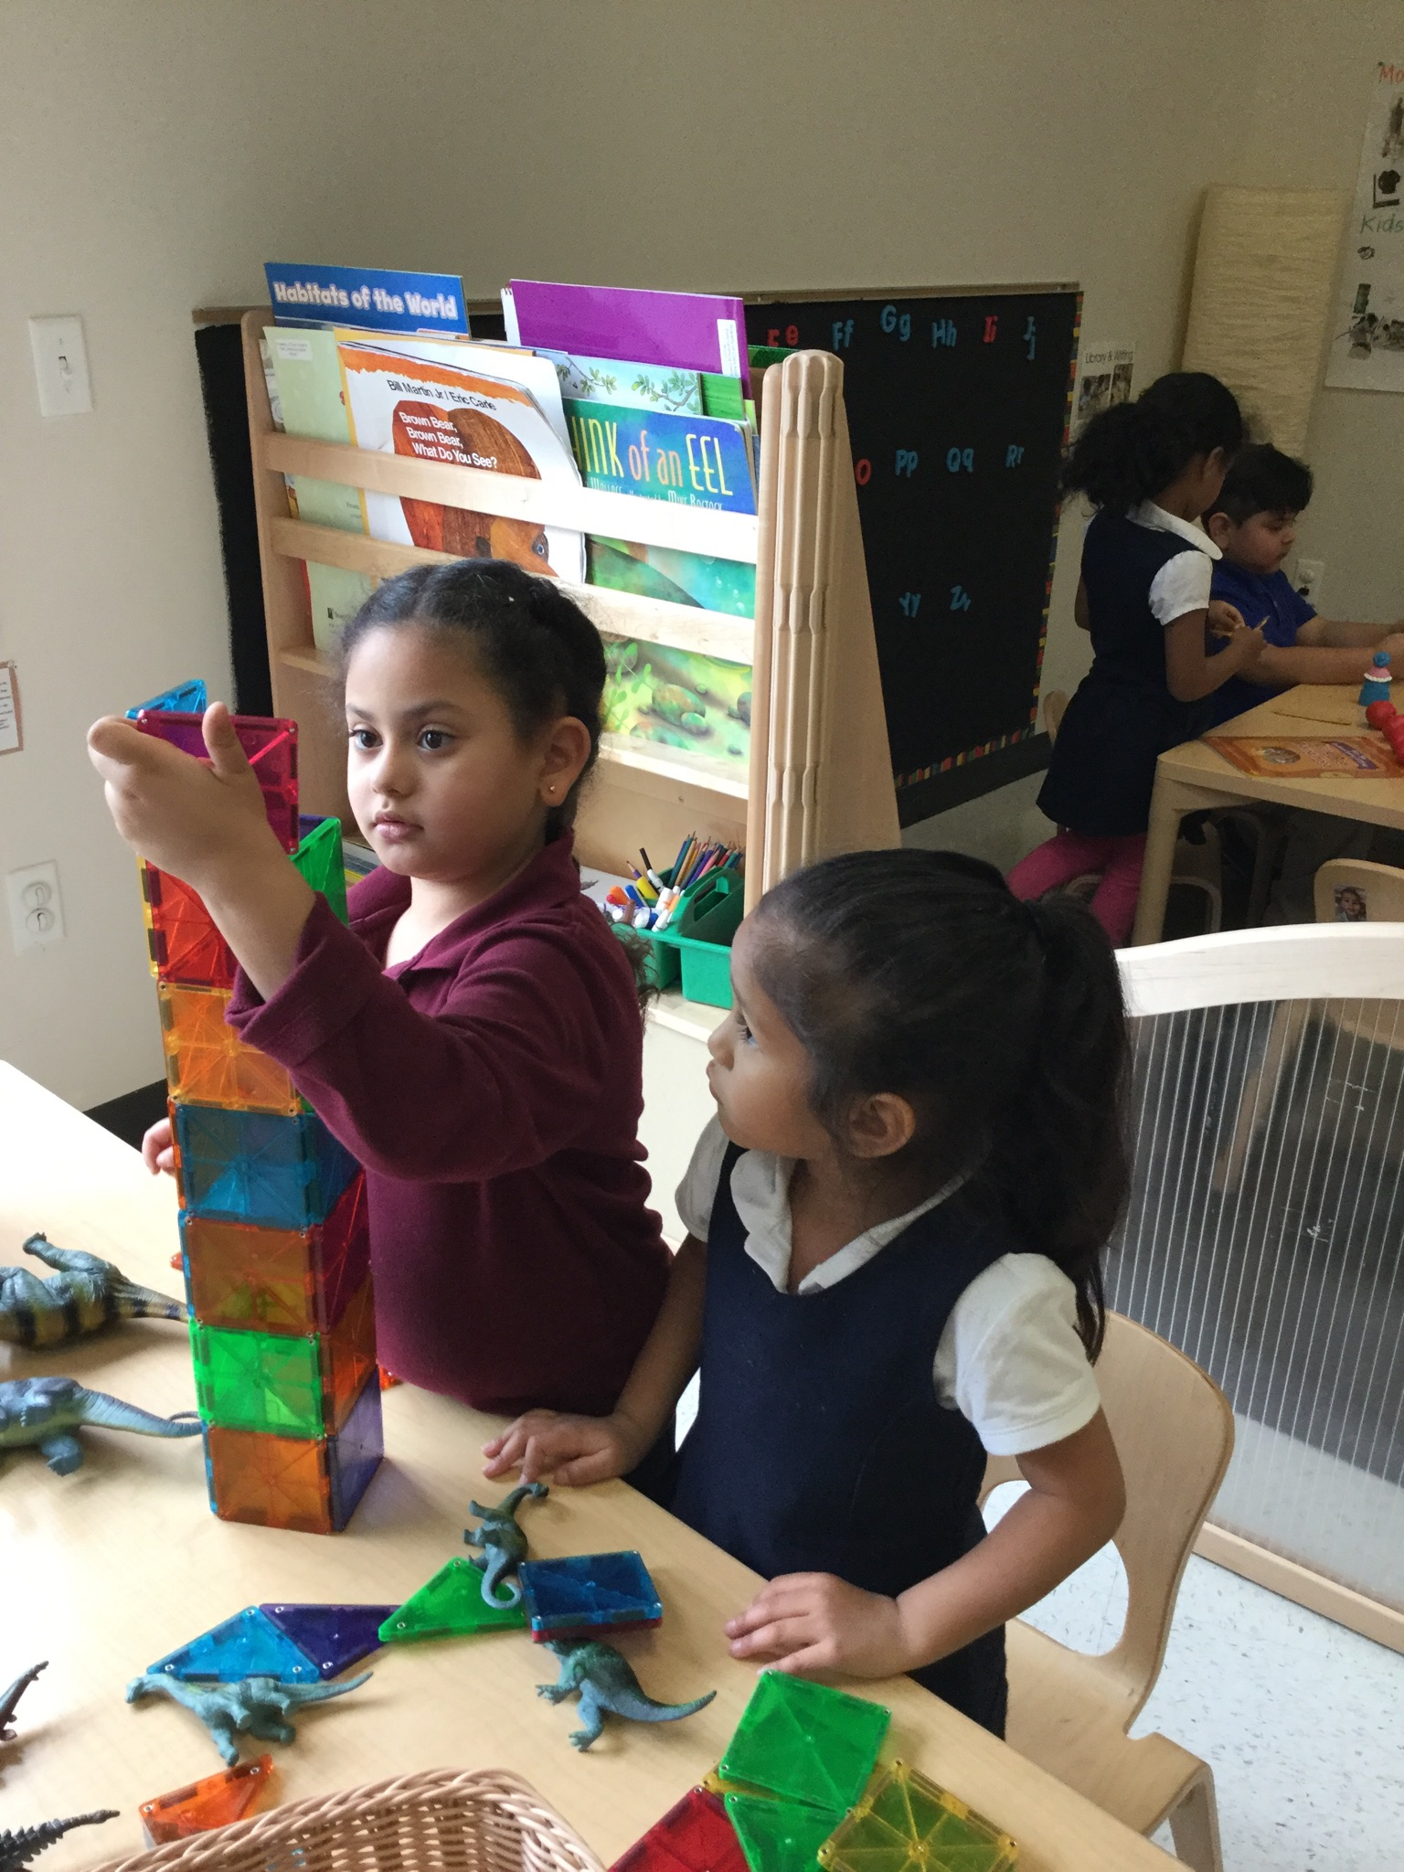
Providing Early Math Opportunities
CHALK PROFESSIONAL DEVELOPMENT SERIES

Slide 2
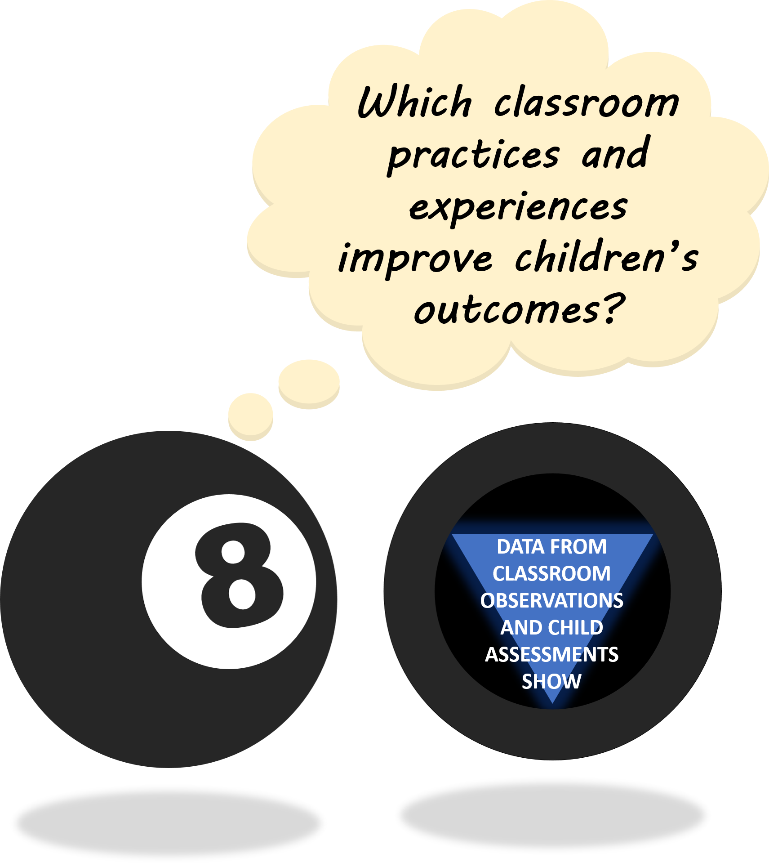
THE “MAGIC 8” CLASSROOM PRACTICES
Reduce time spent in transition
Improving level of instruction
Creating a positive climate
Increasing teacher listening to children
Planning sequential activities
Promoting associative and cooperative interactions
Fostering high levels of engagement
Providing math opportunities
★ 2017-18 Initiative: Focus on Literacy ★

Slide 3


THE IMPORTANCE OF EARLY MATH
In a landmark 2007 study, Duncan and colleagues found that early childhood math knowledge and skills predict BOTH later math and reading achievement, while literacy skills only predicted reading.
Math skills are also related to children’s Executive Functioning skills (attention, working memory, inhibitory control)
Children who participate in more math activities have stronger math gains.
This difference was even more pronounced for children who started pre-k with weaker math skills.
Math activities are “sequential” in nature – a series of steps; require children to plan
Math activities can also encourage associative and cooperative learning among children by requiring them to work together to accomplish a task
Notes:
Icebreaker/pop quiz activity: which skills are related to math…

Slide 4

MATH IN TYPICAL PRE-K CLASSROOMS
When compared with other content areas, Math activities…
* Are more engaging for children:
* Promote more sequential thinking:
* Encourage children to work together:
Math Activity
Non-Math Activity
Math Activity
Non-Math Activity
Math Activity
Non-Math Activity
Yet, children were only engaged in Math activities an average of
7 minutes a day!
DISCUSSION POINT:
Why do we see so little math in Pre-K classrooms?
Involvement in Learning (1-5 scale)
% Sequential Learning Activities
Associative/Cooperative Interactions
Notes:
41% none
21% toys/games
15% (literacy,reading,writing,la)
7% science
4% social studies
Spring 2016
N =26 classrooms

Slide 5
STRATEGIES FOR PROVIDING MATH OPPORTUNITIES
The Pre-K classroom offers opportunities to take advantage of children’s natural curiosity to develop mathematical concepts and understanding. This involves…
Understanding key math concepts for early childhood
Intentionally planning for math on a daily basis
Using manipulatives and hands-on activities to explore and extend children’s math thinking
Embracing unexpected opportunities for math exploration
DISCUSSION POINT:
Are there some math skills that you are more comfortable teaching than others?

Slide 6
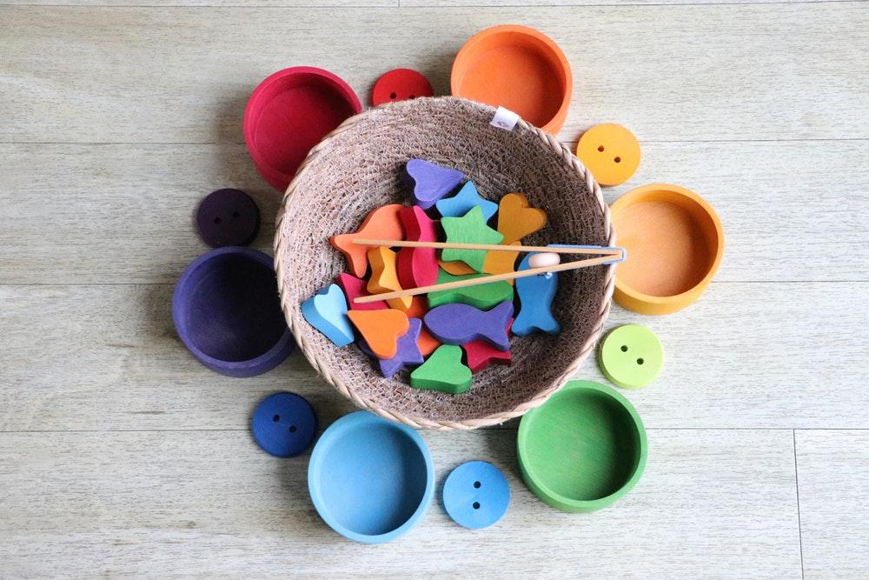
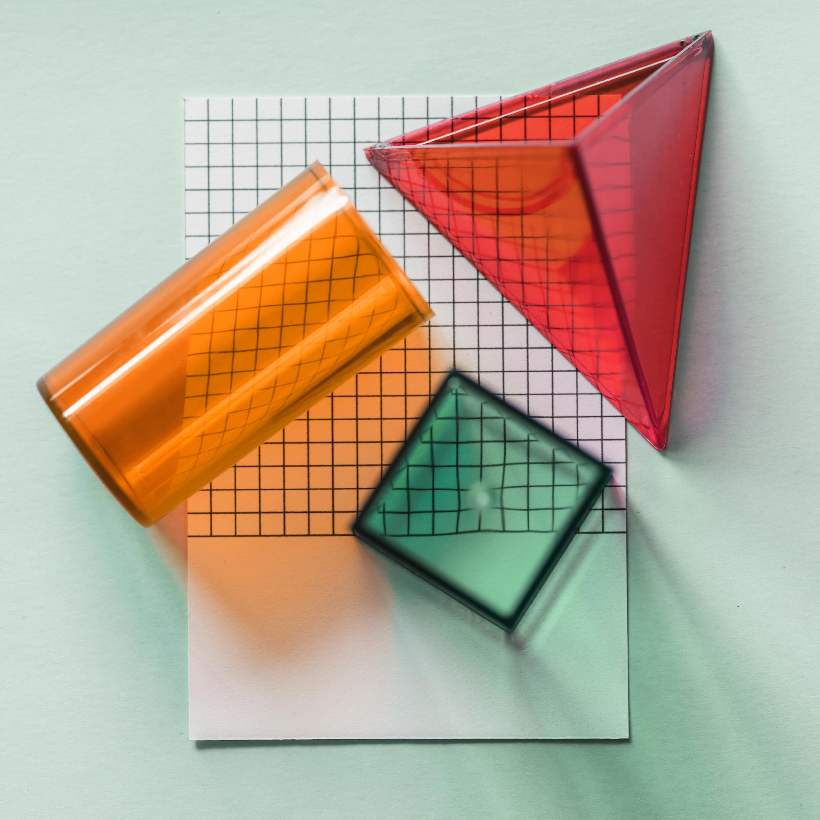
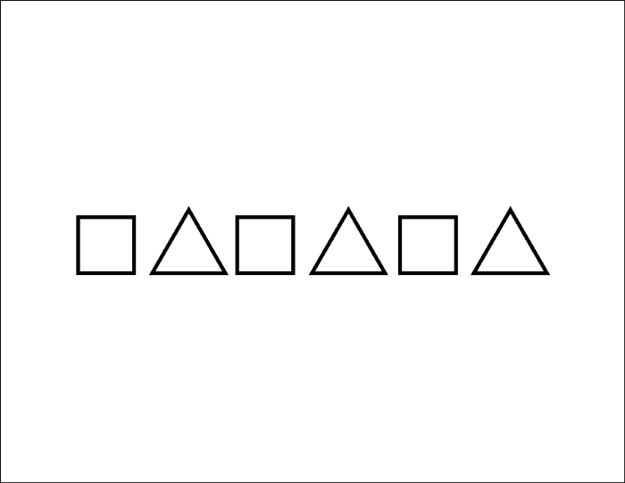
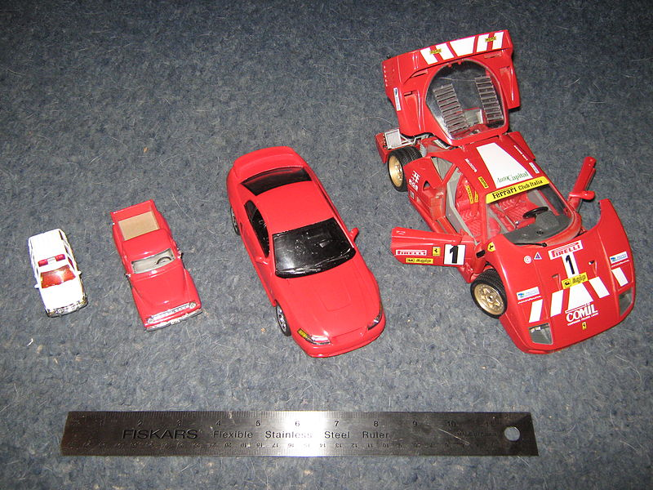
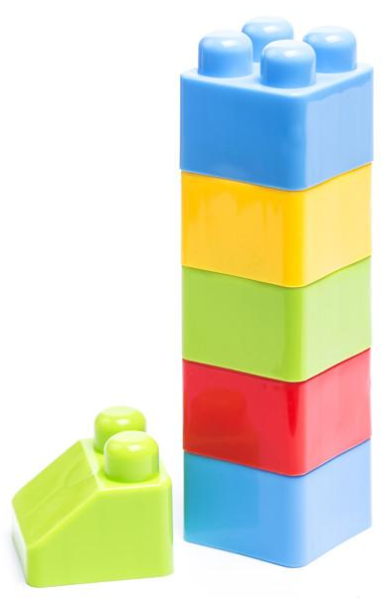
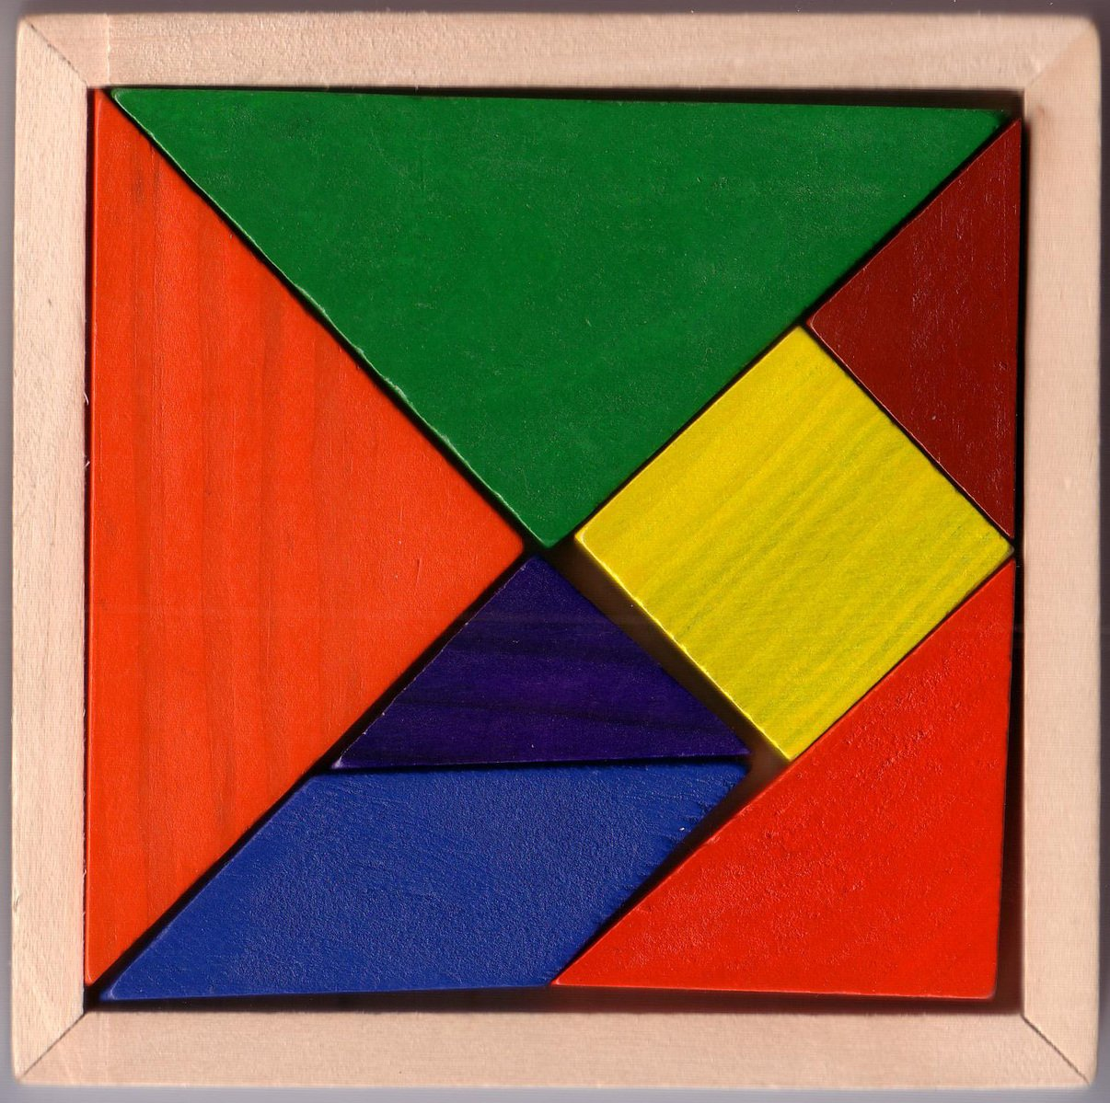
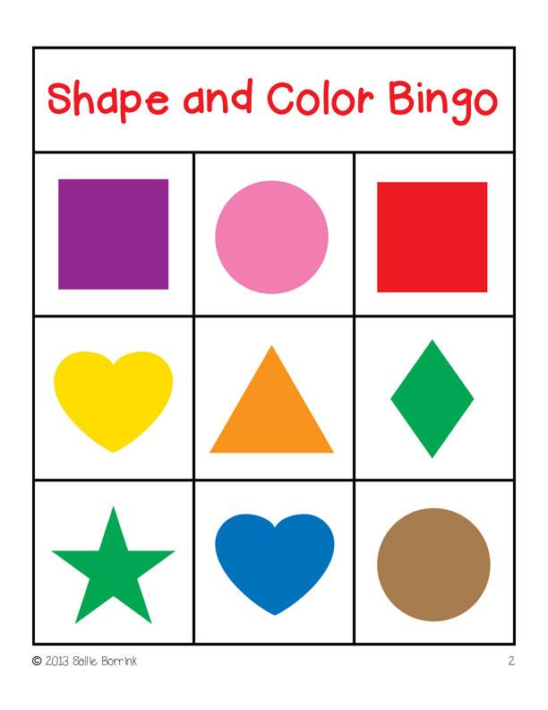
1. KEY EARLY MATH CONCEPTS: MORE THAN COUNTING TO 10 (OR EVEN 100)!
Counting
Quantity
Comparison
Order
Numerals
Operations
What number is two numbers AFTER 3?
Data Analysis
Number &
Operations
Sorting/Classifying
Representing Data
Describing Data
What number comes right BEFORE 10?
Patterns & Algebraic Thinking
Shape & Space
Transformations
Visualization
Measurement
Measurement Attributes
Comparing & Ordering
Behaviors & Processes
Geometry &
Spatial Sense
Notes:
Discussion Point: What kinds of math concepts do you typically focus on with your pre-k students?
NUMBERS & OPERATIONS
Most easily identified, most important math content in early childhood classrooms; rightfully receives most emphasis
Counting
Number sequence: names and correct order of numbers; usually recited by rote; 11, 12, 13, etc. can be challenging exceptions to the pattern
One-to-one correspondence: one number name is given/matched to one and only one object in a set (e.g., touch each one)
Cardinality: last number named when counting a set tells how many
Quantity (Sense of Number)
Understanding how many are in a set (one of the first number ideas a child demonstrates)
Includes subitizing (identifying quantity without counting)
Comparisons (More-Fewer or More-Less)
Children can compare by sight or by matching objects in different sets
Often don’t have the vocabulary to describe
Order
First, second, third indicate sequence
Used to describe place in line or position of items in a row
Most children easily understand the meaning of first, but struggle with other ordinal numbers
Numerals
Numerals : Math :: Letters : Literacy
Should identify symbols that correspond with words in number sequence
Writing numerals not as important in preschool
Combining Operations (Adding)
Combine sets to find how many in all
Example simple word problems (possibly from WJIII?)
Separating Operations (Subtracting)
Young children usually understand take away
Child has a set, removes some, must find how many are left
Sharing Operations (Dividing)
Children begin to understand dividing/making groups when they share objects with others
Also tied to concept of fairness
Set-Making Operations (Multiplying)
Making equal sets (everyone needs 4 crayons, 3 utensils)
DATA ANALYSIS
Sorting & Classifying
Skill used across content areas (e.g., wild vs domesticated)
Progression: color🡪size🡪shape (other attributes used inconsistently)
Representing Data
Developmental progression: physical objects🡪pictures🡪symbols;
Describing Data
Vocabulary: more, fewer, same number as, larger than, smaller than, not 🡨connect number with data analysis
Must be able to compare sets of objects based on specific attribute (has, doesn’t have)
More complex than sorting; requires children to articulate what attribute sorting by
GEOMETRY & SPATIAL SENSE
Shape
Naming shapes isn’t the most important aspect but exposure to proper geometric names is beneficial
Recognize, build with, illustrate, describe attributes, compare shapes, sort by characteristics
Encourage children to predict what happens when multiple 2D and 3D shapes put together
Space
Relationship words: near, under, by, on top of, right, left
Follow simple verbal directions or simple maps/diagrams (e.g., the cube is under the table)
Should be able to identify shapes positioned in multiple orientations (use triangles as example)
Transformations
Sliding, flipping, turning, combining are important skills
Work puzzles, fit blocks on shelf, mold clay into models, create symmetrical shapes
Visualization
Mentally picture/represent shapes
Need practice seeing shapes from different orientations/perspectives
MEASUREMENT
Measurement Attributes
Length, capacity, weight, area, time
Children often overuse “big” and “little”, need awareness of other terms that differentiate attributes
Comparing & Ordering
Start by comparing two objects (taller/shorter) 🡨natural inclination
More complex: comparing 3 or more objects/events and placing in order 🡨requires problem solving and experimental experiences
Measurement Behaviors & Processes
Conservation: set maintains same quantity no matter how parts are re/arranged (e.g. liquid in diff sized containers, length of bent object)
Transitivity: if length A is less than length B, and length B is less than length C, then length A is less than length C
Unit: number and size of units is used consistently for measurement of one object (also appropriateness of units for particular attributes)
Children experiment with nonstandard measuring tools (straws, paperclips, yarn); precursor to understanding the need for/process of standard measurement
PATTERNS & ALGEBRAIC THINKING
Patterns
Children naturally notice patterns
Extending patterns: More complex skill is extending patterns in consistent ways; transfer from one representation to another (e.g., AABAABAAB could also be stomp-stomp-clap, stomp-stomp-clap) 🡨reading patterns in different ways
Growing patterns, e.g. plus-one (stair step); Old Lady Lived in a Shoe;
Change
Children often discuss qualitative change (I was little, now I’m big; when I was a baby, ____, but now that I’m bigger, ____)
Can also describe quantitatively (e.g., change in own height)

Slide 7
WE’RE GOING ON A BEAR MATH HUNT…
Divide into teams of 2-3 people each
Visit a classroom
(not one of those represented on your team)
Gather 5 different math materials in 6 minutes
Calculate scores:
Review the materials each team has gathered, and consider the following questions:
DIRECTIONS & SCORING:
Go back to your own classroom
Divide into teams of 2-3 people each & visit a classroom
-OR-
How children typically use these materials in your classroom?
Are there some materials that seem more engaging than others?
1 point for each math component area represented (number, geometry, measurement, etc.)
1 bonus point for each math material gathered from outside “toys and games” or “math” center
1 bonus point for unconventional math materials (e.g., art materials, books, dramatic)
Team with the highest total score wins!
How do you introduce/set up these materials in centers?
Which math skills/components are promoted by these materials?

Slide 8
2. PLANNING FOR MATH EVERY DAY
Daily routines (calendar, lining up, tallying votes or attendance)
Spontaneous comments and conversations during center time
Meal-time conversations
Whole group lessons to model skills or introduce materials; asking children to share their work or strategies
Small group lessons to teach specific concepts
Let’s vote on what we should study next. We will make a graph to see which topic wins…
How many more forks do we need for the blue table?
What kind of pattern can we make today when we line up?
DISCUSSION POINT:
How do you currently incorporate math content throughout the day?
Notes:
A unit/study on construction naturally lends itself to exploring measurement concepts, etc.

Slide 9
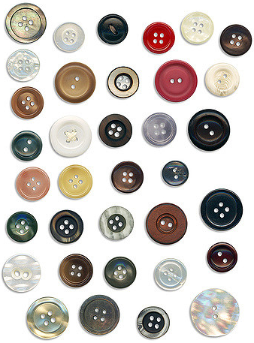

3. MANIPULATIVES AND HANDS-ON ACTIVITIES
Playing with manipulatives and talking about math provide experiences and insights for both the teacher and the child.
For children, math manipulatives are objects that provide concrete opportunities for thinking out loud about math.
For teachers, math manipulatives are tools to help foster and clarify a children’s math understanding.
Notes:
Suggestions from coaches:
2+3 = 4…
Counting/cardinality (let’s count again together, touch each one just once)
Size vs quantity ( 3 big cubes not more than 4 little cubes)

Slide 10
4. EMBRACING SPONTANEOUS MATH MOMENTS
Keep your eyes open and your ears on!
Provide math materials and encourage play in a “math-y” way
Call attention to quantity in everyday interactions
Talk with a child one-on-one to probe his/her thinking
Discover what the child doesn’t know
How do you know the quarters are heavier than the pennies?
Do you have the same number of blocks as me?
Notes:
ADDITIONAL DISCUSSION QUESTIONS
What kinds of math concepts do you typically focus on with your pre-k students?
How do you currently incorporate math content throughout the day?
Are there some math skills that you are more comfortable teaching than others?
Why do you think we don’t see more math in early learning classrooms?
How will you introduce new activities or materials to children? What is your learning goal?
What kinds of questions can you ask to explore and inspire children’s math thinking?
How will you support children who need extra help?
How could you make this activity more challenging for children with advanced skills?
Once you encourage children to “Think like Mathematicians”….
How will you support children who need extra help?
How could you make this activity more challenging for children with advanced skills?

Slide 11
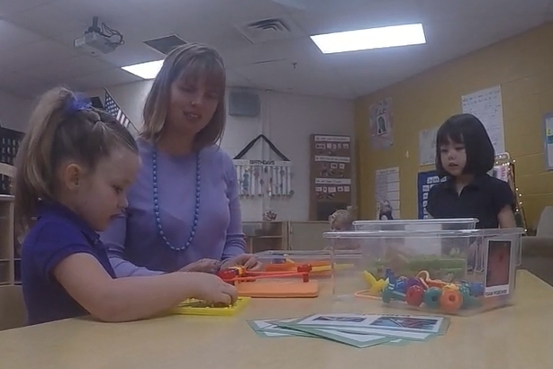
SAMPLE CLASSROOM VIDEO 1: SUPPORTING CHILDREN’S EXPLORATION DURING CENTERS
As you watch, consider…
How do the materials support this interaction?
How does the teacher build on the child’s math exploration?
How does the teacher support the child’s understanding?
What skills are being targeted here?
Are there aspects of this interaction that could be helpful for you to try?
MNPS pre-k teacher Jessica Farmer supports a child’s math exploration during free choice centers
Used with permission
Notes:
https://youtu.be/4j4dyqQ0TJ0
**may need to find different video before publishing materials. I think this might be the one with a single unconsented child jumping in the background…**

Slide 12
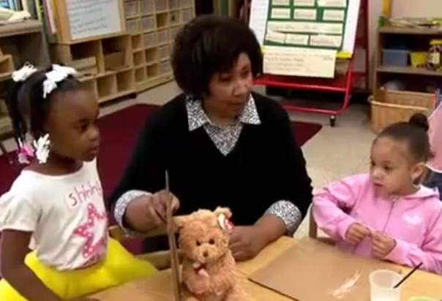
SAMPLE CLASSROOM VIDEO 2: LINKING MATH AND LITERACY
As you watch, consider…
What kinds of questions does she ask?
How does she respond to children’s contributions/attempts?
How does the teacher support the child’s understanding?
How can you incorporate math into literacy or other activities in your classroom?
Pre-k teacher Cathy Foote uses a story book (Goldilocks and the Three Bears) to introduce a lesson on measurement
Let’s Measure: In the Classroom | PBS KIDS Lab
Notes:
https://mpt.pbslearningmedia.org/resource/kids-lab-classroom-virtual-prek-lets-measure/lets-measure-in-the-classroom-pbs-kids-lab-virtual-pre-k/#.Wsvqdy7waCo

Slide 13

SPECIAL THANKS & ADDITIONAL RESOURCES
We are grateful to the following MNPS Pre-K Instructional Coaches and Multi-Classroom Leaders for their invaluable feedback in developing these materials:
SeTara DeThrow
Carrie Head
Susan McClain
Stephanie Mullins
Holly Stone
Ashley Aldridge Wilson
Rhiannon Wilson
https://my.vanderbilt.edu/mnpspartnership/

Slide 14
INDIVIDUAL IMAGE SOURCES
FREQUENTLY USED IMAGES*
ADDITIONAL IMAGE SOURCES
Lightbulb | myiconfinder.com
Designed by Vexels.com:
Hand drawn magnifying glass
Hand drawn bar graph
Pie chart hand drawn doodle
Hand drawn wall clock
Hand drawn cloud bubble
Hand drawn open book
Cog wheel hand drawn icon
Slide 3: scribble chart | pixabay.com
Slide 6: bingo | weclipart.com
Slide 6: Geo blocks | unsplash.com
Slide 6: Scale model comparison | en.wikepedia.org
Slide 6: Sorting objects | unsplash.com
Slide 6: Block stack | freepik.com
Slide 6: Pattern | weclipart.com
Slide 6: Tangram | freepik.com
Slide 9: Jax pattern | freeimages.com
Slide 9: Buttons | flickr.com
*These graphics are used as icons throughout the series. For example this lightbulb clipart appears beside most “Discussion Point” questions.

